Slide 1

Data Analyst Capstone Project
Piyush Kumar Sharma
November 11, 2026

Slide 2



OUTLINE
Executive Summary
Introduction
Methodology
Results
  Visualization – Charts
  Dashboard
Discussion
  Findings & Implications
Conclusion
Appendix

Slide 3

EXECUTIVE SUMMARY
We studied the Stack Overflow developer survey (65,437 respondents) plus job and salary data.
Top languages today: JavaScript, HTML/CSS, Python, SQL, TypeScript
Python becomes #1 next year; Rust and Go enter the top 10
PostgreSQL is the top database now and next year; SQLite and Supabase rise
Most job postings: Washington DC, Detroit, Seattle, New York
Swift pays the most ($130,801); Python and C++ follow

Slide 4

INTRODUCTION
Why this report, who it is for, and why it matters
Purpose: show which technologies developers use today and want to use next year
Audience: students, job seekers, hiring managers and IT leaders
Value: helps people decide which languages and databases to learn
Questions: Which languages and databases lead? Where are the jobs? Which languages pay most? Who are the developers?

Slide 5

METHODOLOGY
Data sources, data collection and data wrangling steps
Sources: Stack Overflow Developer Survey (65,437 respondents), a Jobs API (7 locations), and a web-scraped table of languages and salaries
Collection: Python (requests, BeautifulSoup, pandas); saved as job-postings.xlsx and popular-languages.csv
Wrangling: split multi-answer columns, counted each technology, ranked the top 10
Compared "worked with" (current year) to "want to work with" (next year)
Visuals: bar charts and a 3-tab Excel dashboard

Slide 6

Results
Job postings, language salaries and technology trends.

Slide 7
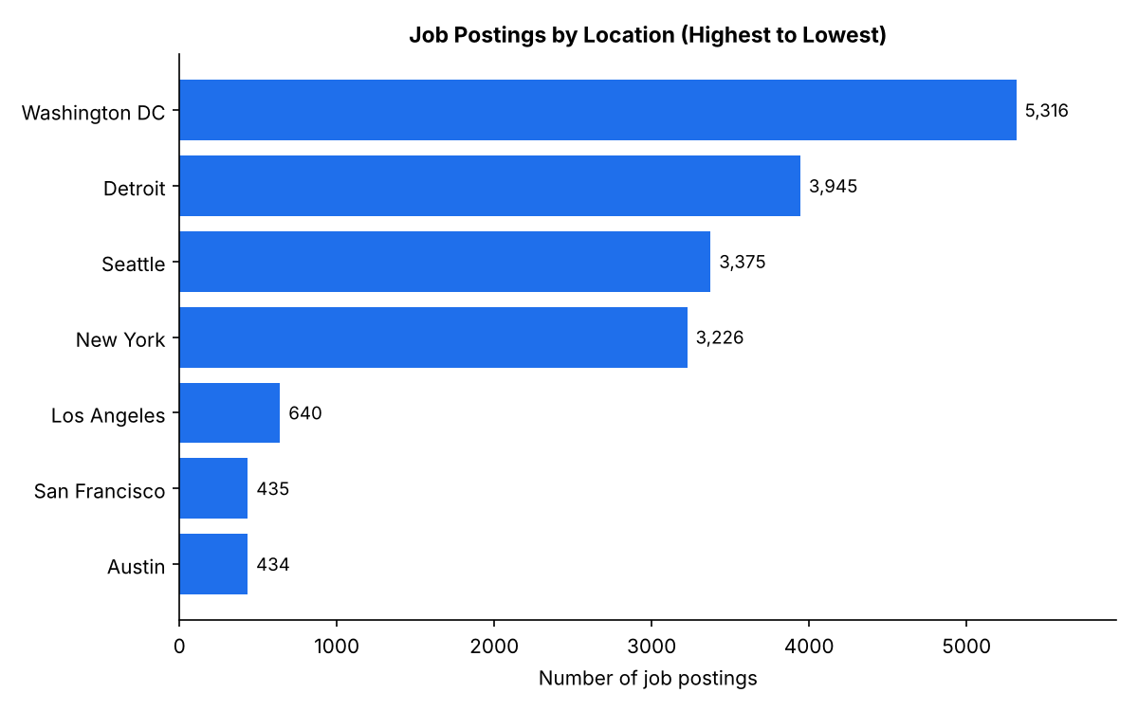
JOB POSTINGS
Washington DC has the most job postings (5,316).
Detroit, Seattle and New York each have more than 3,000.
Los Angeles, San Francisco and Austin have far fewer (under 700).
Source: Jobs API from the course (7 locations).

Slide 8
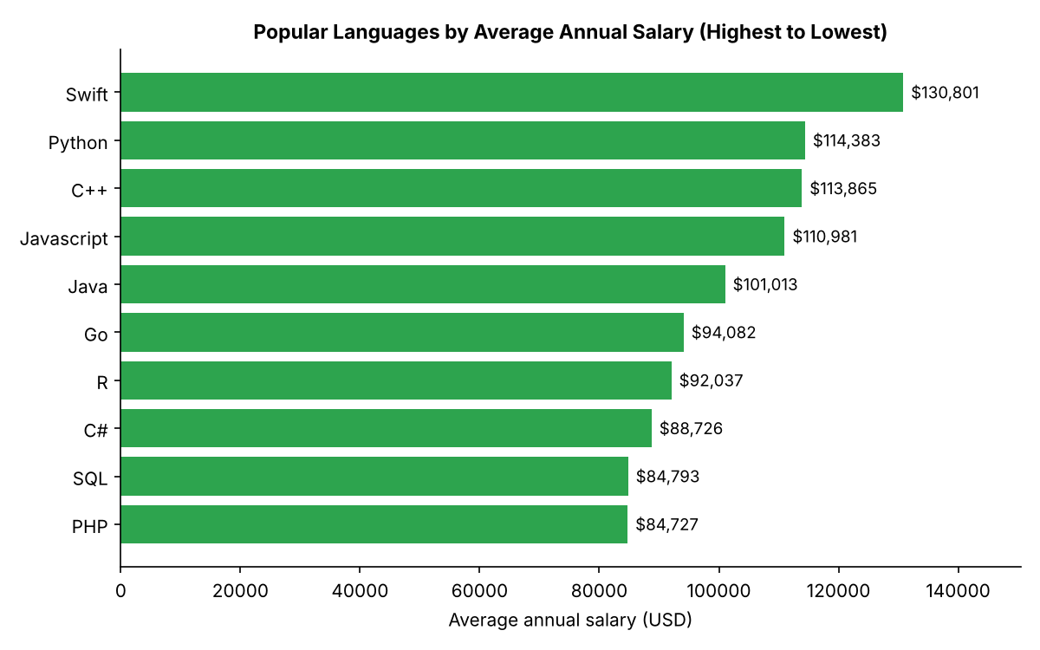
POPULAR LANGUAGES
Swift pays the most: $130,801 a year on average.
Python ($114,383), C++ ($113,865) and JavaScript ($110,981) follow.
SQL and PHP are lowest in this list, at about $84,700.
Source: web-scraped table of popular languages.

Slide 9
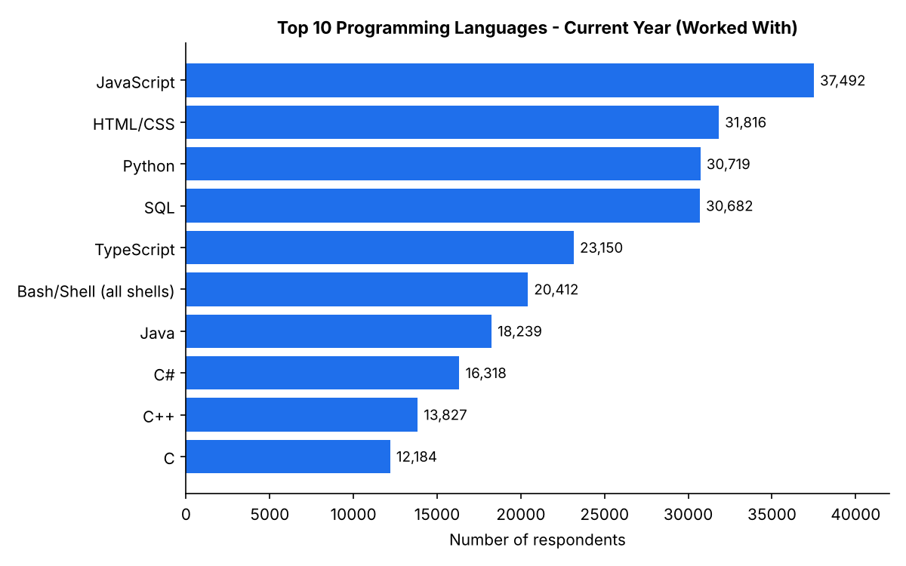
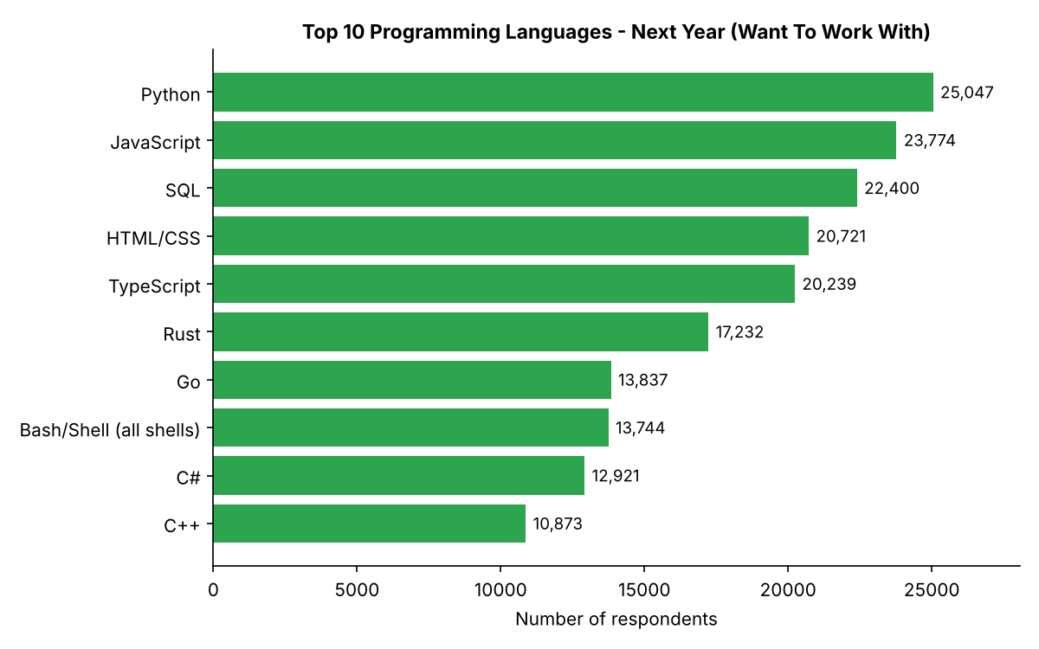
PROGRAMMING LANGUAGE TRENDS
JavaScript leads today; Python moves to #1 next year, and Rust and Go enter the top 10.
Current Year
Next Year

Slide 10
PROGRAMMING LANGUAGE TRENDS - FINDINGS & IMPLICATIONS
Findings
JavaScript is #1 today (37,492); Python is #1 next year (25,047)
Rust and Go enter the next-year top 10; Java and C drop out
Web languages and SQL stay strong in both years
Implications
Python and SQL are the safest skills to learn
Rust and Go are good extra skills to stand out
Expect less demand for Java and C

Slide 11
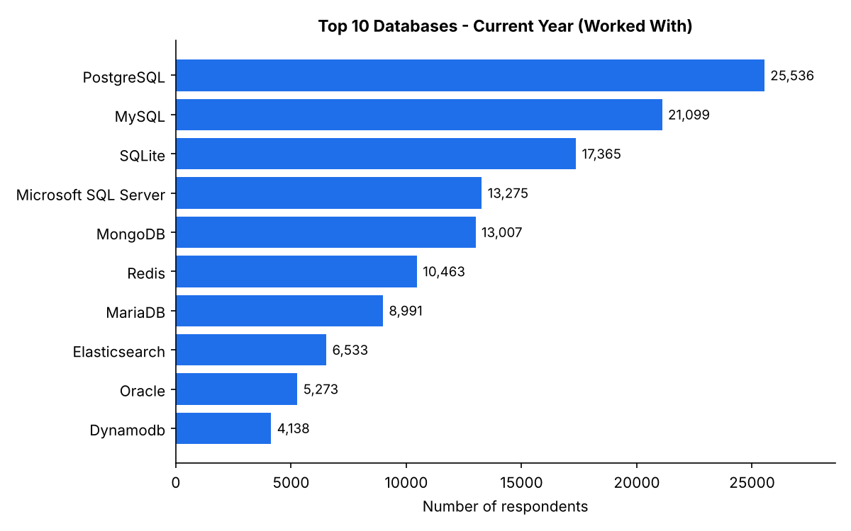
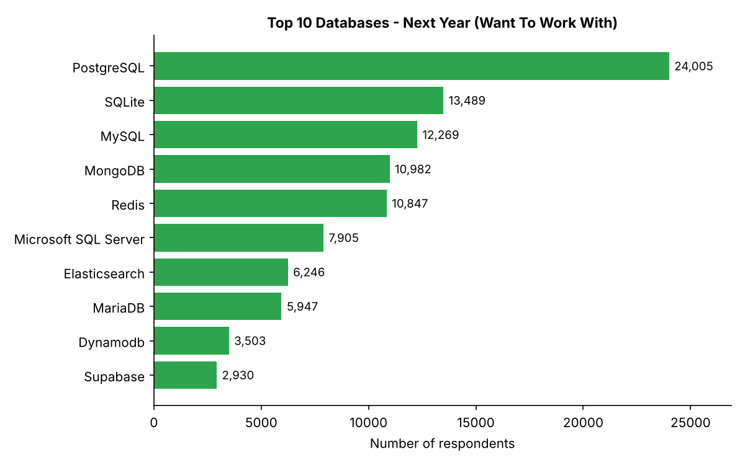
DATABASE TRENDS
PostgreSQL leads now and next year; SQLite moves to #2 and Supabase enters the top 10.
Current Year
Next Year

Slide 12
DATABASE TRENDS - FINDINGS & IMPLICATIONS
Findings
PostgreSQL is #1 in both years by a wide margin
MySQL falls from #2 to #3; SQL Server falls from #4 to #6
Oracle leaves the top 10; Supabase enters
Implications
Learn PostgreSQL first
Older enterprise databases are losing interest
Easy, newer databases like SQLite and Supabase are growing

Slide 13

DASHBOARD
A 3-tab Excel dashboard built from the survey data.

Slide 14
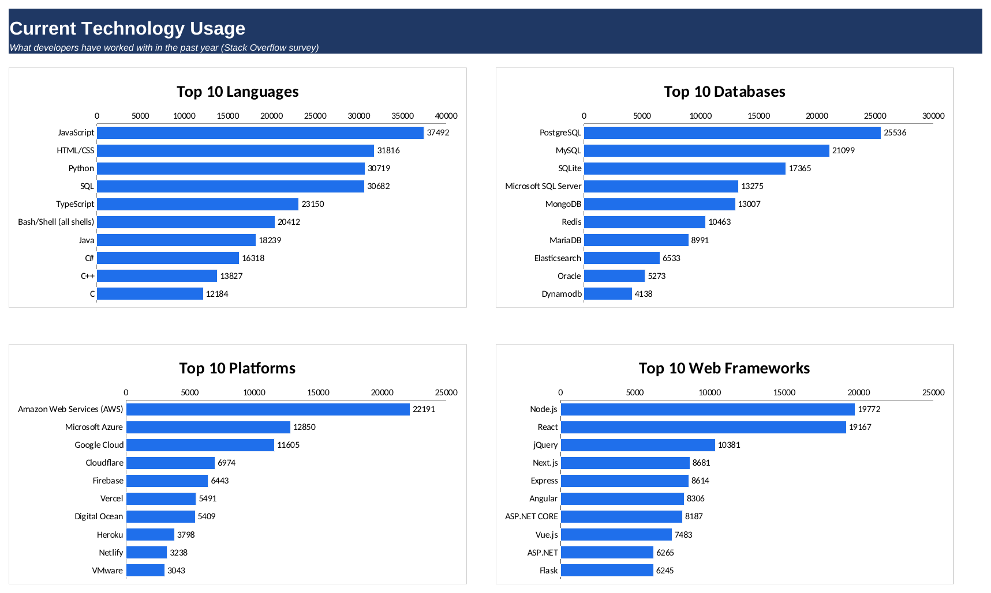
DASHBOARD TAB 1: Current Technology Usage
Dashboard Insight
JavaScript is the most used language (37,492), then HTML/CSS, Python and SQL.
PostgreSQL is the top database, ahead of MySQL and SQLite.
AWS leads platforms (22,191); Node.js and React lead web frameworks.

Slide 15
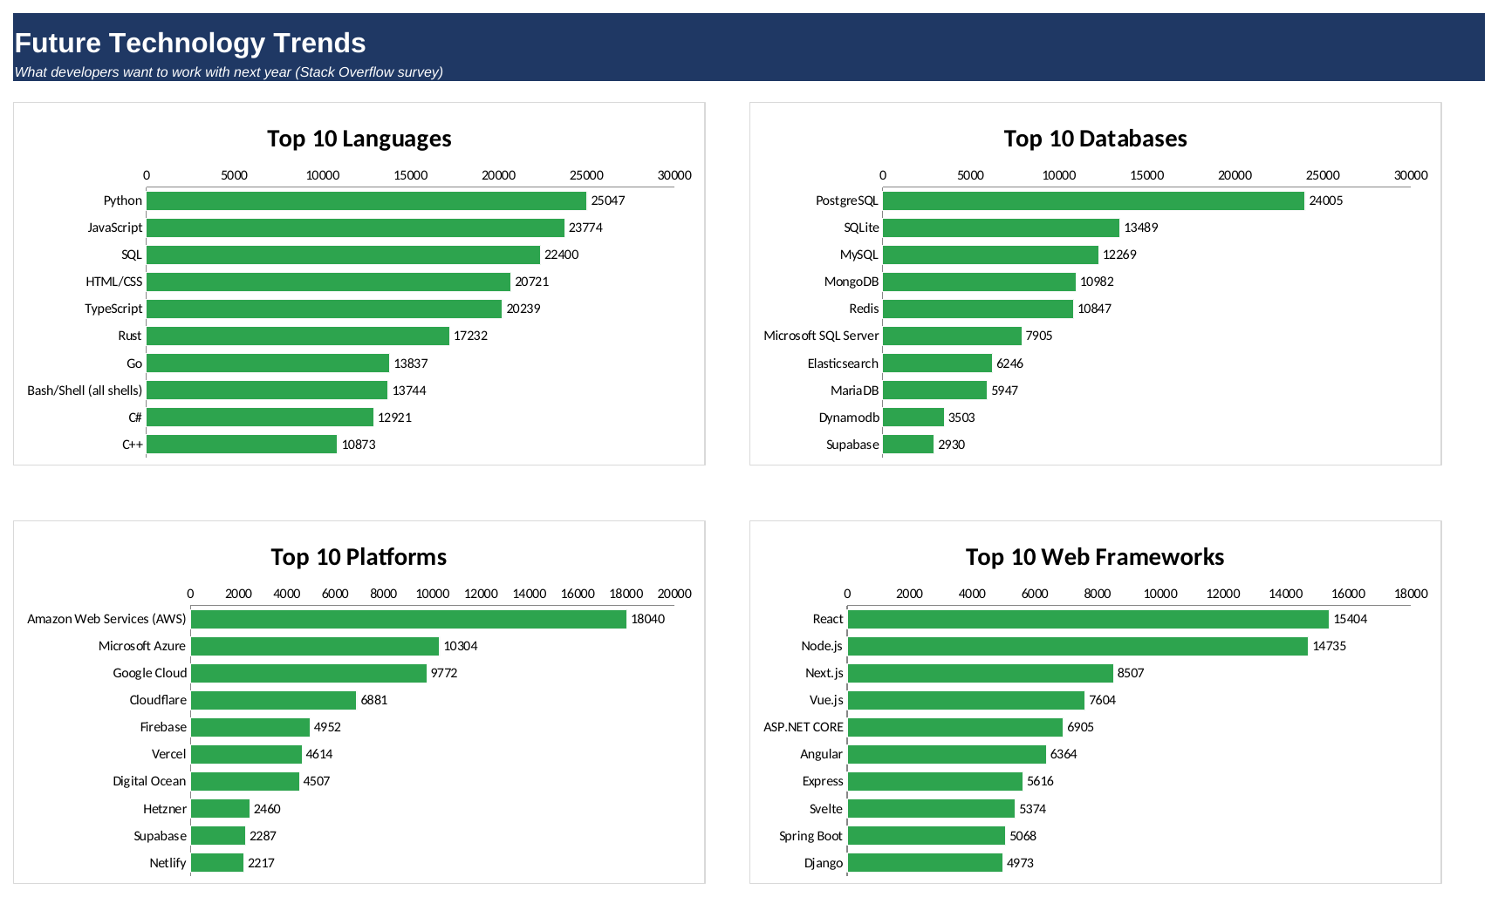
DASHBOARD TAB 2: Future Technology Trends
Dashboard Insight
Python moves to #1 next year; Rust and Go enter the top 10.
PostgreSQL stays #1; SQLite moves up to #2.
React moves ahead of Node.js; Supabase, Svelte and Hetzner appear.

Slide 16
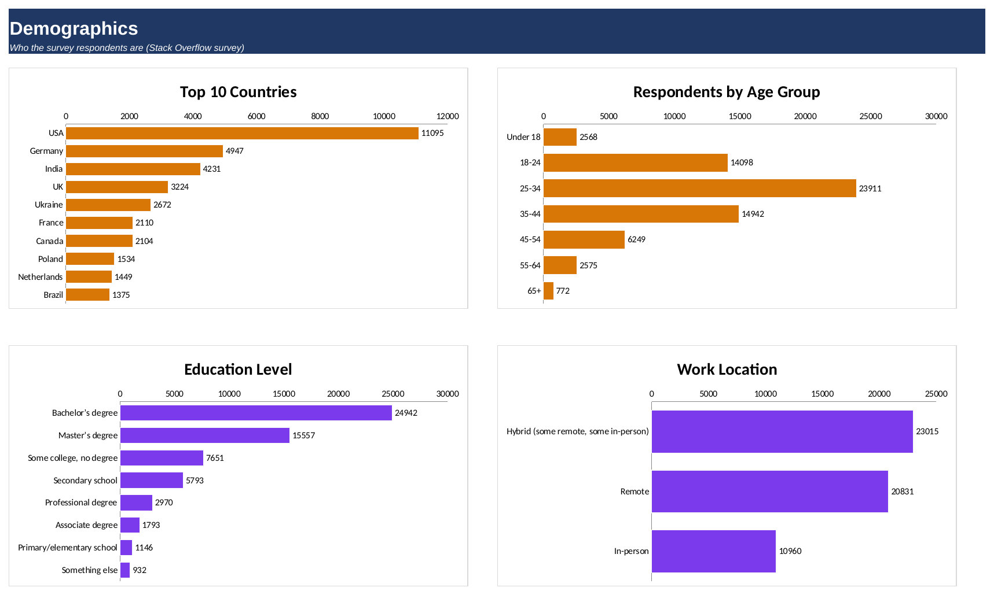
DASHBOARD TAB 3: Demographics
Dashboard Insight
The USA has the most respondents (11,095), then Germany and India.
Ages 25-34 are the largest group; a Bachelor’s degree is the most common.
Most people work hybrid (23,015) or remote (20,831).

Slide 17
DISCUSSION
Developers use web languages and SQL most today, but want Python even more next year.
Cloud (AWS, Azure, Google Cloud) and open-source databases lead; PostgreSQL is the clear favorite.
React and Node.js lead web frameworks; newer tools like Svelte and Supabase are rising.
Most respondents are 25-34, hold a Bachelor’s degree, and work hybrid or remote.

Slide 18
OVERALL FINDINGS & IMPLICATIONS
Findings
Python, JavaScript and SQL are core skills now and next year
PostgreSQL leads databases; SQLite and Supabase are growing
Most developers are 25-34, hold a Bachelor’s degree, and work hybrid or remote
Implications
Learn Python and SQL first, then add JavaScript or TypeScript
Add PostgreSQL and a cloud platform such as AWS
Job seekers can target Washington DC, Detroit, Seattle, New York and remote roles

Slide 19

CONCLUSION
Python, JavaScript, HTML/CSS and SQL are today’s core languages; Python leads next year.
PostgreSQL is the top database now and next year.
AWS leads cloud platforms; React and Node.js lead web frameworks.
Python and SQL give the best mix of demand and pay.

Slide 20

APPENDIX
Capstone_Dashboard.xlsx holds the data tables behind all dashboard charts.
Platforms and web frameworks (top 10, current and next year) are shown on the dashboard slides.
Files used: survey data (65,437 rows), job-postings.xlsx, popular-languages.csv.

